Slide 1
Technin 510 Week 5
Python DevOps
10/27/21

Slide 2
Today
Web Programming Basics
GitHub, Azure, CodePen Tutorial
Lunch
Technin510 L5 Deploy a Python Model

Slide 3
Features for Visual Data
The Internet
Webpages are files on server hard drives
Your computer is not a server because it is not directly connected to the “internet”. It is a client, that connects to the internet via an ISP
Information is sent/received via “packets”
Routers direct your packets around the internet (upwards of 15 routers may be involved in the sending/receiving of your information)
Wrappers around packets help routers send packets to the right places
E V E R Y T H I N G connected to the internet has its own unique IP address to send/receive these packets to the right place
Hypertext Transport Protocol (HTTP) is the language sent between clients and servers

Slide 4
Structuring a WebApp
Our Python Code
Python
API
Web App
JS/HTML/CSS
Examples/Docstrings
Python (Flask)
HTTP requests
Front End
Azure App Service
Github
CodePen
pypi

Slide 5

GitHub: A place to put your things
Largest platform for collaborating on software
Bug/fixes are posted through GitHub “Issues”
Branches of code “alternate timelines” allow you to safely make changes to the software
Once an administrator approves changes, branches can be merged into the master branch
add, commit, push

Slide 6
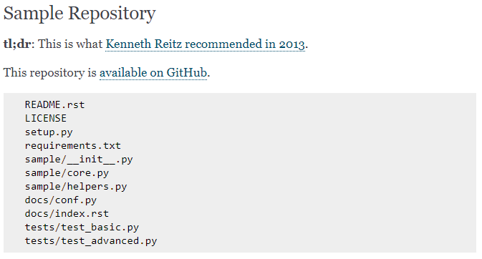
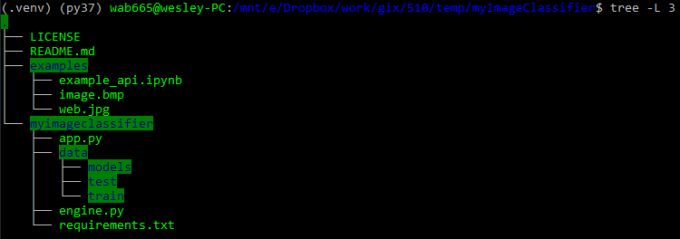
GitHub: once we put it there, we want to make it easy to follow
Hitchiker’s guide to python has good documentation on this
Essential files: README, LICENSE, setup.py, requirements.txt
Essential structure:
‘<my_project_name>/’ contains your application files
‘docs’ contains the code for generating your documentation (for places like readthedocs.io)
‘tests’ contains your test suite

Slide 7
.gitignore: please ignore this stuff
Sometimes we create files inadvertently when we build and test. We don’t want these files included as our source code
Some files we don’t want to include also may contain private information/data
When you initialize a repository on GitHub you can select prefabricated .gitignores based on language

Slide 8
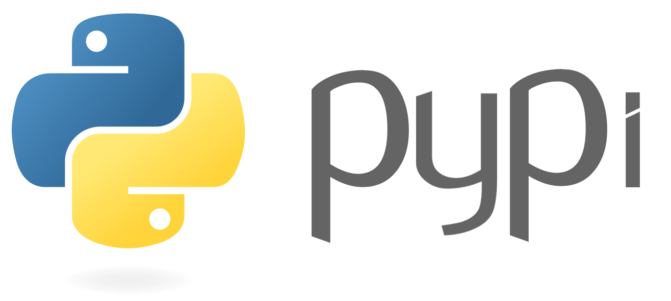
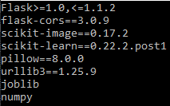
Pypi: If we were really doing this right we’d put our things here too
Software repository for the standard python package manager pip
pip install <package>
269,000 packages
Easier hurdles than the Anaconda repository
requirements.txt

Slide 9

Virtual Environments: good for development, necessary for deployment
A virtual environment (also called a venv) is a Python environment such that the Python interpreter, libraries and scripts installed into it are isolated from those installed in other virtual environments
Allows our app service to know how to build our application

Slide 10

Flask: Popular python web application framework
A WSGI (Web Server Gateway Interface) framework. It specifies how servers and applications communicate with each other
Designed to be extremely lightweight and customizable
Used by Airbnb, Netflix, Reddit, Lyft

Slide 11

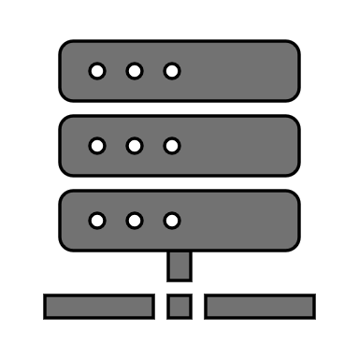


Flask-CORS: Cross Origin Resource Sharing
Cross-origin resource sharing allows you to use resources from other sites in your site, it is how we will connect our azure app to our static front end
AJAX: Asynchronous Java Script is just a way of fetching resources dynamically on a web page from some server
Originally you could only do this kind of resources sharing on the same domain/server (protects your data)

Slide 12

Pickle: because we pickle things to preserve them
Serializes python objects so that they can be saved to a file
Converting any python object into 0’s and 1’ is called pickling (other languages may call it serializing, marshalling, flattening, etc.)
Standard method of saving scikit-learn models
Other ML models (usually NNs) will sometimes use H5 files in the Hierarchical Data Format (HDF) which is essentially a multi dimensional array
In the example we use joblib, which includes pickling in its suite of features

Slide 13

Postman: let’s prototype our HTTP requests
Software development tool that enables people to test calls to APIs

Slide 14
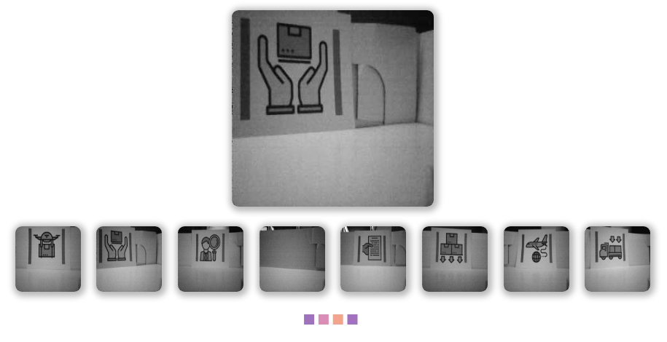
Today’s Lab
Create CodePen and Azure accounts
Install: Python, Azure CLI, git, Postman
Clone repository
Run the example and test with Postman
Deploy to azure
Send requests through app on CodePen
Make a few JS tweaks

